Slide 1


DOODLE
WWW.DOODLE.COM
BIG DATA PROGRAMMING - PYTHON
GROUP - 5

Slide 2





DOODLE
MEET OUR TEAM
Adhirath Erath Balan
(Tasks)
Stack Overflow Data Extraction
Model Training
UI Integration
Sheethal Raghavendra
(Tasks)
Build Flask UI Interface
Presentation
Madhura Aravendekar
(Tasks)
LinkedIn
Git Training Model
Presentation
Gurudarshan Nagaraju
(Tasks)
My SQL Database connection
Data Preprocessing
Chetan Bhilware
(Tasks)
GitHub Data Extraction

Slide 3


DOODLE
AGENDA
•Data Scraping using API
•Database
•Data Preprocessing
•Building Unsupervised Model
•Building Supervised Model
•Web Page UI Interface
•Communicating results via Email.

Slide 4

DOODLE
DATA SCRAPING USING API

Slide 5
DOODLE
STACKOVERFLOW - DATA EXTRACTION
1.Fetching previously stored variables or else initializing new variables
5. Calling extraction_of_users
PACKAGES :
PANDAS
NUMPY
REQUESTS
2. Extracting list of users from Stack Overflow
6. Calling tags_per_user
7. Calling to get processed data
3. Extracting top 'n' tags of a users
4. Preprocess the extracted JSON Data
8. Storing the variables and the data in the respective tables

Slide 6

DOODLE
DATA SCRAPING USING API

Slide 7
DOODLE
GITHUB - DATA EXTRACTION
1
Database Connection Setup
5
GitHub API User Search
2
GitHub API Authentication
6
GitHub API User Information Retrieval
3
MySQL Connection
7
Data Insertion into MySQL Database
4
Database Table Creation
8
Error Handling and Closing

Slide 8

DOODLE
MYSQL - DATABASE

Slide 9









DOODLE
MYSQL DATABASE
Fetched json file from stack overflow
Converted it into CSV
Data cleaning and prepreprocessing
With the help of Python mySQL database was created
Created the tables

Slide 10
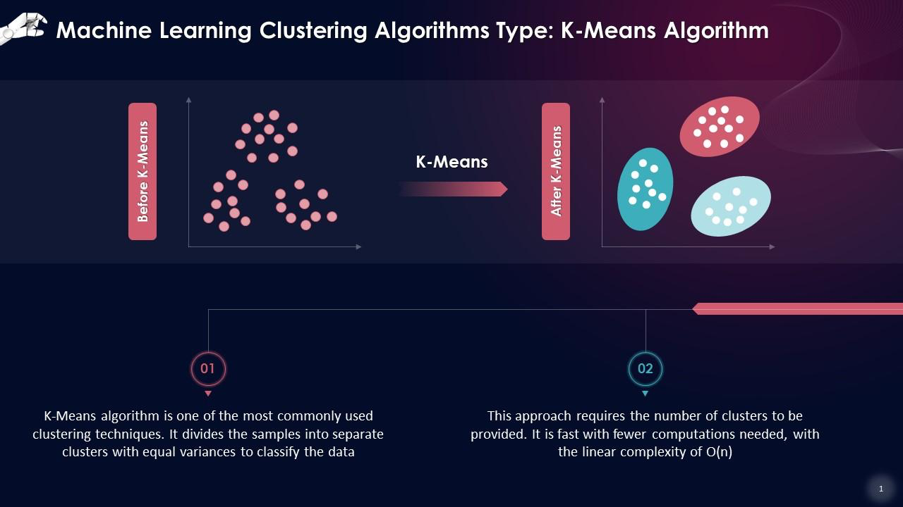
DOODLE
UNSUPERVISED LEARNING - STACK OVERFLOW

Slide 11
Initiating Connection to Mysql Database
Retrieving the data from the database
DOODLE
Label the data according to the output
Building the K-Mean Clustering
1
2
3
4
5
6
7
8
SQLALCHEMY
sklearn.cluster(kMeans)
Sklearn.preprocessing (StandardScaler)
skearn.metrics import silhouette_score
pickel
Initializing Variable
Find out the optimal K value
Preprocess the data
Inserting the label data into the database

Slide 12


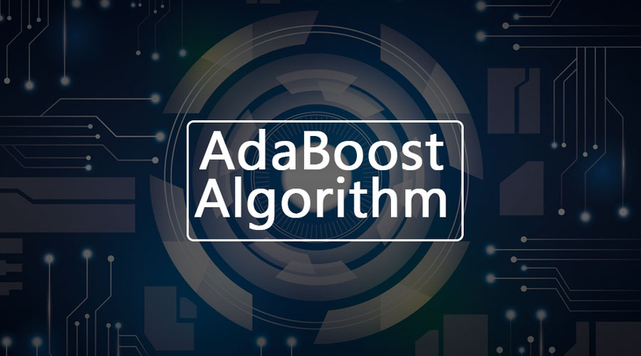
DOODLE
SUPERVISED LEARNING - STACK OVERFLOW

Slide 13





DOODLE
Libraries Used :
Sqlalchemy
sklearn.model_selection(train_test_split)
Sklearn.ensemble (AdaBoostClassifer)
skearn.metrics (precision_score, recall_score, f1_score, roc_auc_score, accuracy_score, confusion_matrix
sklearn.svm (svc)
Xgboost(XGClassifier)

Slide 14
Loaded XGBoost, SVM, AdaBoost classifier if exists, else creating a new one
DOODLE
Defined the features for training the models
Connecting to the database
1
2
3
4
5
6
7
Created class Stack Overflow Prediction
Created path to save and load model and scaler object
Loaded the scaler object from file
Fetching training data from database
Split the training data into training and testing sets
Making predictions
8
9
10
11
12
Preprocessing and fetching data for prediction
Train the models
Calculating evaluation metrics

Slide 15
DOODLE
UNSUPERVISED LEARNING - GITHUB

Slide 16
Initiating Connection to Mysql Database
Retrieving the data from the database
DOODLE
Label the data according to the output
Building the K-Mean Clustering
1
2
3
4
5
6
7
8
SQLALCHEMY
sklearn.cluster(kMeans)
Sklearn.preprocessing (StandardScaler)
skearn.metrics import silhouette_score
pickel
Initializing Variable
Find out the optimal K value
Preprocess the data
Inserting the label data into the database

Slide 17

DOODLE
SUPERVISED LEARNING - GITHUB

Slide 18
DOODLE
Libraries Used :
Sqlalchemy
sklearn.model_selection(train_test_split)
Sklearn.ensemble (RandomForestClassifier, AdaBoostClassifer)
skearn.metrics (precision_score, recall_score, f1_score, roc_auc_score, accuracy_score, confusion_matrix
Xgboost(XGClassifier)

Slide 19
Loaded XGBoost, Random Forest, AdaBoost classifier if exists, else creating a new one
DOODLE
Defined the features for training the models
Connecting to the database
1
2
3
4
5
6
7
Created function GitHub Prediction
Created path to save and load model and scaler object
Loaded the scaler object from file
Fetching training data from database
Split the training data into training and testing sets
Making predictions
8
9
10
11
12
Preprocessing and fetching data for prediction
Train the models
Calculating evaluation metrics

Slide 20

DOODLE
WEB PAGE UI INTERFACE

Slide 21






DOODLE
Stage 2
Stage 4
Flask App Initialization
Login Route (/login)
Logout Route (/logout)
Stage 6
Index Route (/)
Stage 1
Stage 3
Stage 5
Import Necessary Modules
Session Management
Search Route (/search)
Stage 7
Stage 9
Technical Recruiter Route (/technicalrecruiter):
Mail Routes (/sendmail, /successmail, /rejectedmail)
Stage 8
Stage 10
Human Resource Page Route (/humanresourcepage)
Run the Flask App

Slide 22
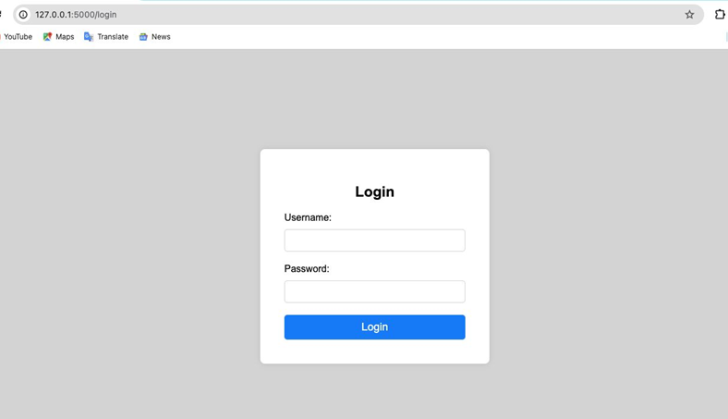
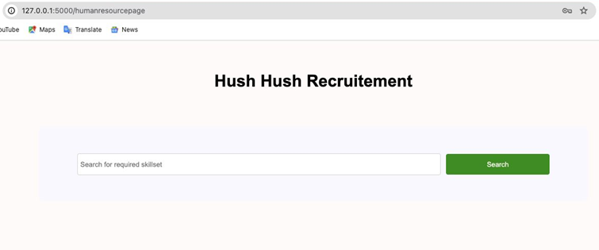
DOODLE

Slide 23
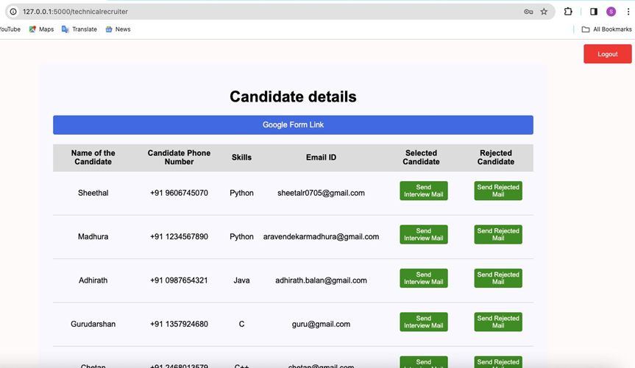
DOODLE

Slide 24


DOODLE
Home
Photo
About Us
Contact
TASKS ACHIEVED
Data retrieved from StackOverflow and GitHub has been stored in a database.
The K-Means Unsupervised Model was selected for data labeling.
The model was trained using labeled data and subsequently saved.
Utilizing the trained model for making predictions.
A Flask UI has been developed for HR to search and email candidates based on their skillset. The Technical Recruiter can then review candidates, evaluate their code, and send interview or rejection emails with participation certificates.

Slide 25



DOODLE
FUTURE SCOPE
Improve UI with responsive design.
Dockerize and deploy each component on GCP.
Utilize asyncio or threading for faster data fetching. Consider fetching data on-demand if retrieval takes 1-2 minutes instead of storing in a database.
Perform code evaluation via unit testing and analyze Time and Space Complexity using an LLM Model API.

Slide 26
DOODLE
WWW.DOODLE.COM
THANK YOU

